Slide 1
Facial Recognition Technologies:
Ethical Concerns and Recommendations
By: Jaiden Atterbury, Xavier Lee, and Nicholas Yu

Slide 2
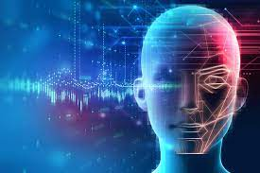
Introduction
What are FRTs?
Facial recognition technologies (FRTs) are a tool that has become more and more prominent over the years.
FRTs are the set of digital tools that perform tasks on human faces through the use of images and/or videos.
What are common uses of FRTs?
face detection
face attribute classification/estimation
face verification
face identification
However FRTs are not flawless yet. There are numerous ethical concerns over racial biases, privacy implications, and the broad concept of liability.

Slide 3
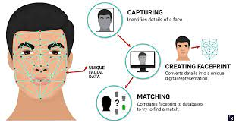
Technical Details:
How do FRTs usually work?
In general, facial recognition works by identifying and measuring certain facial features in an input image, also known as a query image.
Stages of an FRT:
Capture and Detection
Faceprint
Enrollment
Gallery
Comparison
1-to-1 and 1-to-Many
Similarity Scores
Matching Decision
Threshold
Additional Procedures

Slide 4

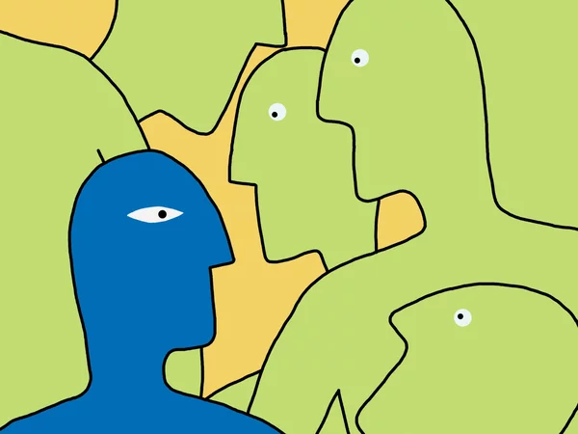
Ethical Concern #1: Racial Bias
FRTs are 5-10% less accurate when identifying people of color
Can lead to false arrests, misidentifications, and other unjust outcomes
Algorithm prioritizes facial features that are more easily distinguished in lighter skin tones
Eye shape, width of the nose, size of the mouth, shape of the chin

Slide 5
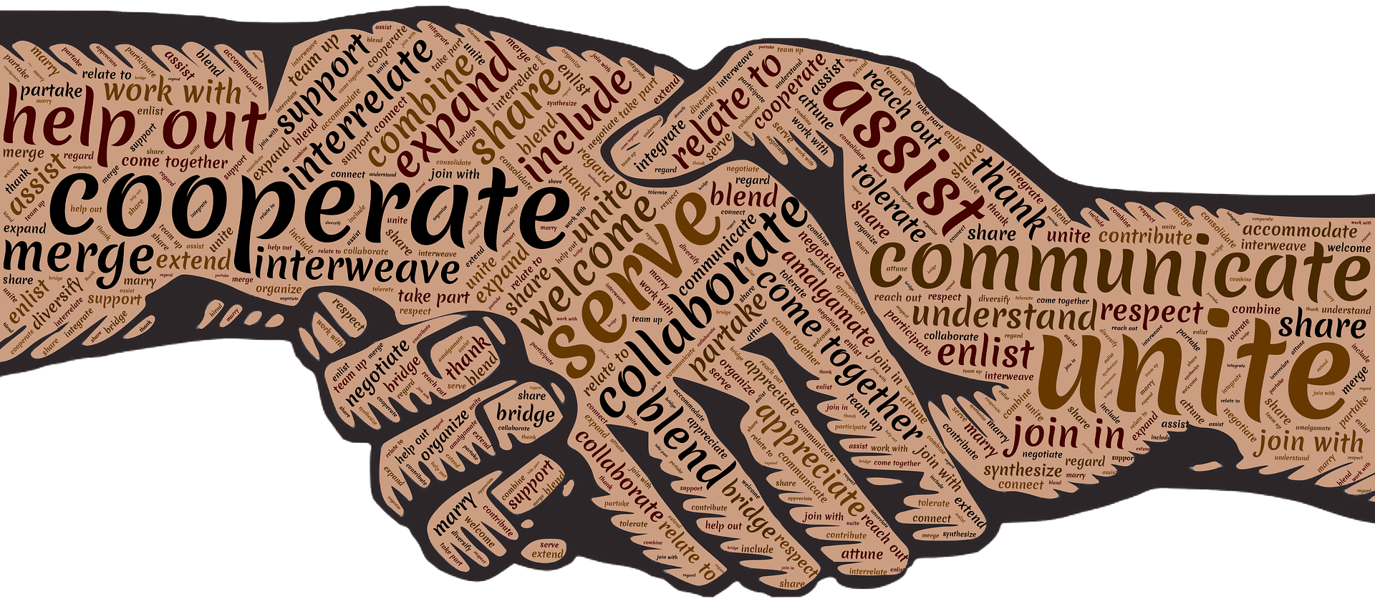
Existing Solutions
Researchers are stretching the domain of facial features and racial characteristics FRTs are utilizing in their analysis
Led to a 1% improvement in reducing racial bias and has increased the accuracy of facial recognition across all ethnicities

Slide 6

Recommendations
Refrain from using FRT for any type of law enforcement until racial bias has been completely eliminated
Require more diverse training datasets that include people of different races, ethnicities, and with a variety of skin tones and hair colors
Redesign the algorithm to focus on facial features that aren’t related to race or ethnicity
Regularly review and update FRT to ensure high accuracy and unbiasedness
Provide transparency and accountability in facial recognition design and implementation
Educate the public about the potential for bias in FRT

Slide 7

Ethical Concern #2: Lack of Informed Consent
Privacy infringements have become one of the general public’s main concerns with FRTs, mainly due to a lack of transparency in how information is stored and managed.
The most prevalent and scrutinized privacy implication of facial recognition technology is the use of the technology to identify individuals without their consent,
This includes using applications such as real-time public surveillance or through databases that are not lawfully constructed.

Slide 8


Existing Solutions: The GDPR
What is The GDPR?
The General Data Protection Legislation
The self-proclaimed “toughest” privacy and security law in the world.
Imposes obligations on organizations anywhere, given that they illegally collected data on individuals from the EU.
What does the GDPR do?
Under the GDPR companies can only process data from subjects if the subject gave the company “specific, unambiguous consent” to process the data.
The GDPR levies harsh fines against those who violate the privacy and security standards drafted in the bill.

Slide 9


Existing Solutions: The GDPR
Has it been effective?
The GDPR has been very effective in forcing companies to think strategically regarding the use of consumer data.
Furthermore, the risk of incurring hefty fines has made companies take privacy and security more seriously.
Real world example
Clearview AI, which is self-described as the “world's largest facial network,” allows its customers to compare facial image data to over 10 billion images scraped from the internet.
This database includes facial image data of a “substantial number” of UK citizens without these people's knowledge or consent.
Clearview AI failed to comply with the higher data standards set by the GDPR. This misuse of data of individuals from the UK has led to them receiving a 17 million pound fine.

Slide 10
Recommendations: Generalization of Legislation
Problems with current solutions:
Due to the fact that as of the first quarter of 2022 only 7 states have biometric privacy laws, the legislation is not enough to fully combat this lack of consent in facial recognition.
In states that don’t have biometric privacy laws Americans in facial recognition databases don’t need to be asked for permission to be included in said databases.
Solutions:
In order to fully combat this clear violation of citizens privacy, we must create a task force that would draft an act very similar to that of the GDPR but make it federally effective.
By doing this the act would impose certain obligations on companies/businesses in every state:
Obtaining consent before any collection/use of biometric data.
Explicitly state how the biometric data will be used and stored.
Employ reasonable security measures.

Slide 11

Ethical Concern #3: Liability
Gray ethical areas
Who’s fault is it: the machine or the person?
Clear boundaries have not been established yet

Slide 12
Ethical Concern #3: Liability
If the AI replaces physicians, who is responsible?

Slide 13
Ethical Concern #3: Liability
Company?
Patient?
If the AI replaces physicians, who is responsible?
Physician?
Hospital?

Slide 14

Ethical Concern #3: Liability
Rogers: Plaintiff
BNSF collected biometric data
BUT did not disclose the reason
BNSF: Defendant
Third party collected the information
Hence, we shouldn’t be held responsible
$5,000 x 45,600 = $228 million
BIPA

Slide 15
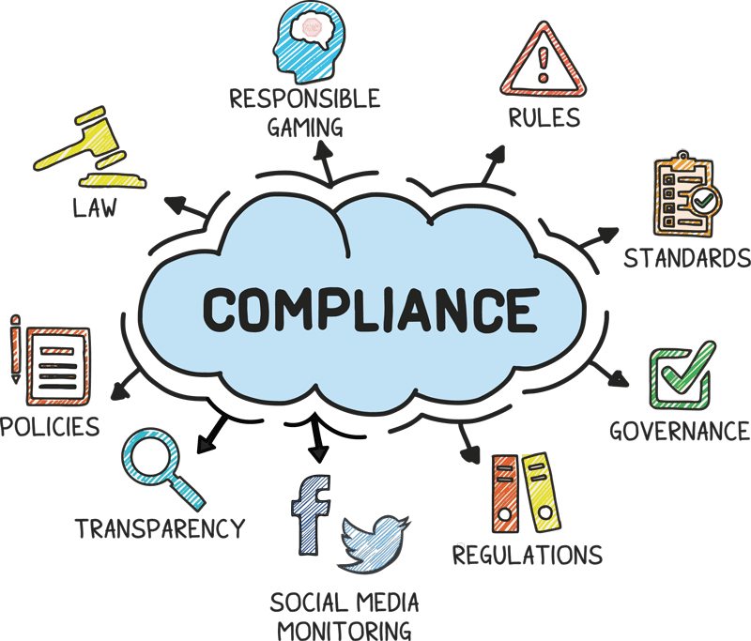
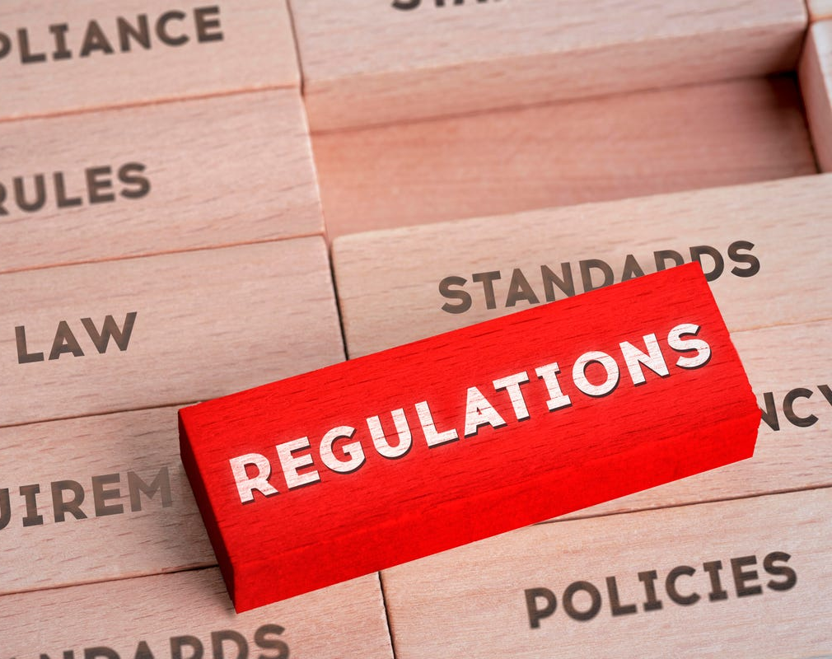
Recommendations
Company’s
More:

Slide 16
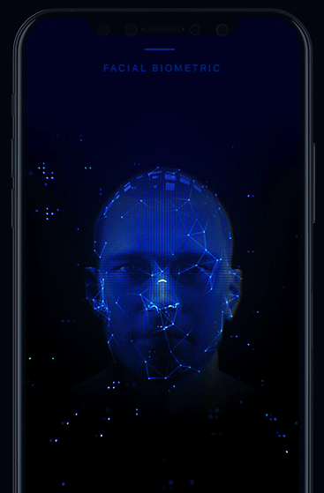
Thank you

